Slide 1
Damien Hirst
Artist

Slide 2

Name
Name: Damien Hirst
Notes:
Damien Hirst is one the finest artists of his generation and the usage of controversial artworks has helped highlight some of the issues that artists shy away from depicting.

Slide 3
Brief Bio
Damien Hirst was born in Britain 1975.
He is famous for deliberate provocations.
He was conceptual craftsman.
He also use art to highlight contemporary issues.
He developed interest of investigating the theme of death as a youngster.
At the age of 16, he started visiting Leeds Medical School to make life arts (With Dead Head).
Notes:
Hirst is renowned for deliberate provocations using art to high social issues such as death, rebirth, and morality. His art has elements of conceptual craftsmanship since it supersedes customary issues. Also, his contemporary art has spread throughout the world since it reflects on the current social organization besides its contention, excellence, and unpredictable style (Blanche).

Slide 4
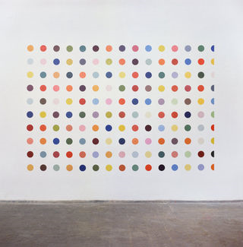

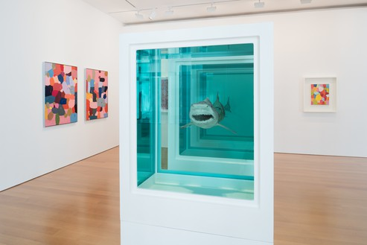
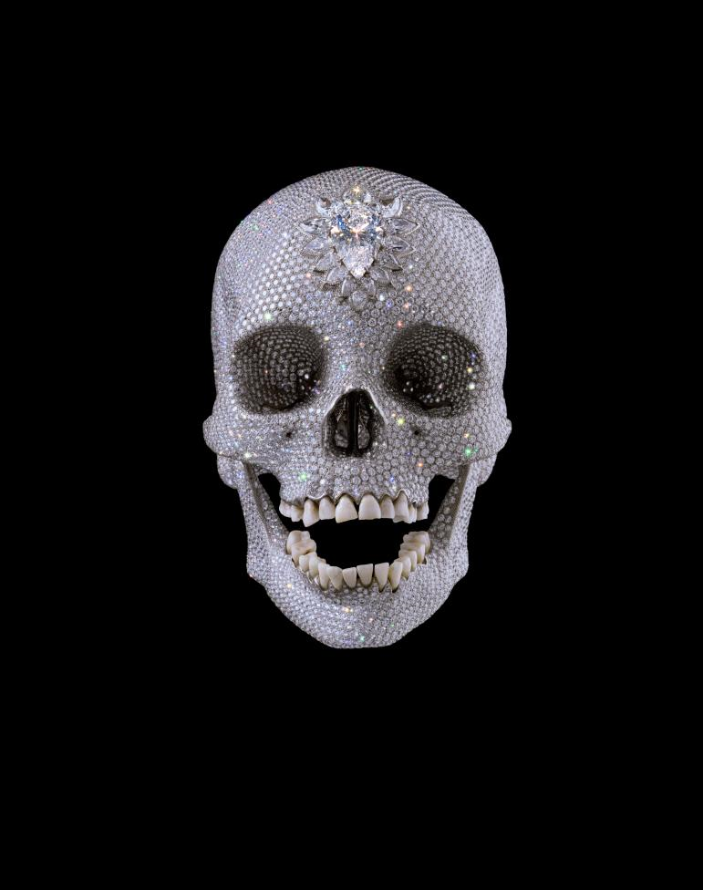
Excellent Reproduction of Art Works
Notes:
The ‘Freeze’ painting composed hued spots distributed onto the center dividers. The spot artistic creation depicted a ‘binding the delight of shading’ while embodying the issues he wanted to highlight. In January 2012, the painting was demonstrated over a phenomenal scope of 11 Gagosian Gallery (Wainwright). He explained that the collection comprised a a “Maps of a man’s life” (Cumming. Secondly, the ‘Medicine Cabinets’ portrayed a way of life where science is the new religion for most individuals. Thirdly, the “Natural History’ artwork entailed protecting in formaldehyde gas chambers to make a “zoo of dead creatures.” Fourthly, “For the Love of Good” (2007) consisted of platinum cast of skull set.

Slide 5
Cited Quotes: Artist
" This art was one of his generally suffering topics that was intensely depicted in the establishment work, 'Pharmacy' (1992).
"It's astounding what you can do with an E in A-Level craftsmanship, a bent creative mind, and a cutting tool," Hirst said in his acknowledgment discourse (Cumming).
"Where's God now? God's screwed off. So all these enormous issues – like workmanship and science and malignancy – are on the whole climbing about on this fruitless scene where God used to exist “ (Aslet).
Notes:
Hirst was articulate on why he made some of his artworks and he did it without fear of criticism. He was different from other artists since he was daring by using elements such as decaying bodies as well as question the existence of God to pass his message. Even though its was an orthodox method, it created so much fuss among pundits and historical center guests.

Slide 6
Critics
According to Julian Spandling, Hirst’s artworks "have no artistic content and are worthless as works of art“ (The Telegraph n. p).
According to Charles Spencer “[Damien Hirst] is a purveyor of cheap and nasty thrills rather than serious enlightenment” (Russeth n.p).
According to Jennifer Kabar, “Hirst is the son of a used-car salesman, which might explain his fascination with wealth” (Russeth, n.p).
Notes:
The critics above do see the value of Hirst’s artworks, and term them as worthless, thrill-oriented, cheap, and profit centered. The critics do not are likely to prescribe to the traditional artistic methods that convey message without using provocative aesthetic elements.

Slide 7
Historians
According to Robert Hughes, "The presence of a Hirst in a collection is a sure sign of dullness of taste“ (The Telegraph n.p).
Notes:
Robert Hughes has deep dislike towards contemporary art that him depict Hirst’s artwork as dull. Like him, many historians and classical artists have refused to embrace the power of contemporary art since he believes that criticizing one’s own culture is absurd and hypocritic.

Slide 8
Works Cited
Aslet, William. "The Unlikely Artists Who Inspired Damien Hirst." Sotheby's, 2018, www.sothebys.com/en/articles/the-unlikely-artists-who-inspired-damien-hirst. Accessed 20 Sept. 2019. Blanché, Ulrich. Banksy and Damien Hirst." Damien Hirst, 2018, pp. 203-230.
Cumming, Prudence. "Damien Hirst." Yorkshire Sculpture International, 2019, yorkshire-sculpture.org/artists/damien-hirst/.
Russel, Andrew.”11 Opinions about Damien Heist.” Observer.
https://observer.com/2012/08/11-opinions-of-damien-hirst/
The Telegraph. “Robert Hughes quotes: on Caravaggio, Warhol, and Hirst.”
https://www.telegraph.co.uk/culture/art/art-news/9458192/Robert-Hughes-quotes-on-Caravaggio-Warhol-and-Hirst.html
The Telegraph. “Damien Hirst should not be in the Tate’ says Critic..” 2019. https://www.telegraph.co.uk/culture/art/9168804/Damien-Hirst-should-not-be-in-the-Tate-says-critic.html
Wainwright, Lisa S. "Damien Hirst." Encyclopedia Britannica, 7 July 2019, www.britannica.com/biography/Damie

